Slide 1
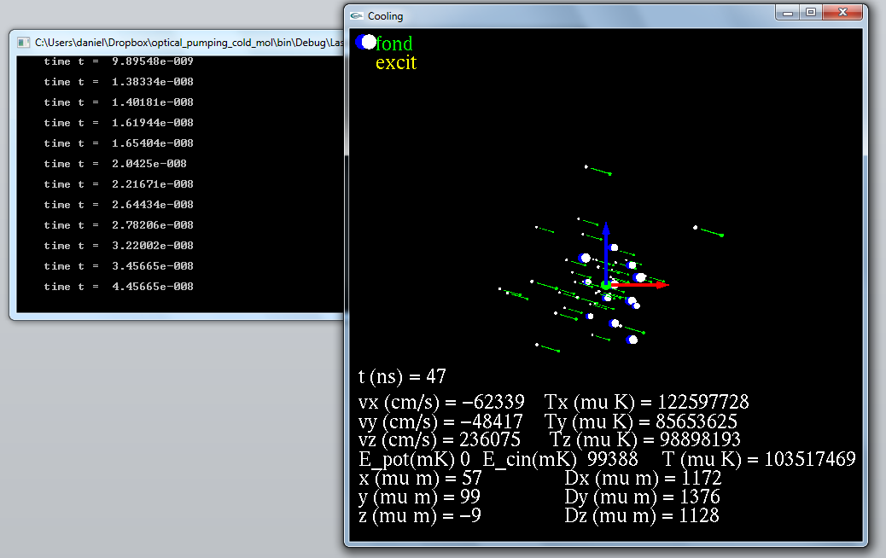
z
J/J_{max}
y
M/J
x
v/v_{max}
Color → electronical state

Slide 2
Evolution in the program
Transitions_initialisation
Initialisation_programme
Main_Laser_Cooling
Define all parametres, tables, … (Read List_Param)
Initialise Levels and Transitions (Read Level and Lines files)
If needed Create new Levels (from Franck-Condon)
LOOP on scanned parameters. Put t = 0
Initialise Molecules (r,v, population), Lasers, Fields
LOOP untill t> t_end
Calcul transitions rates
Predict which reaction and when should occur (t_KMC)
Evolve dynamics (every t_dyn) ← forces + potentials
if t_KMC <t_dyn) evolves also internal states
Each t_dia → output file (sortie donnees)
Each t_out → output graphic (draw)
Transition_rate_calcul
If the molecule has change internal state
Or evergy t_mise_a_jour for all molecules
Caclul for theses molecules the
two level rate for each transition and lasers
Kinetic_Monte_Carlo
KMC algorithm =
Selection of the reaction and time
One_body
Verlet, Boris algorithms to evolve r,v
Shift_molecule
Stark, Zeeman (analytic)
dipolar shift (scan all levels)
Sortie donnees
dipolar shift (scan all levels)
Population in v,J, Level (statistics)
Ex: file_out << Mol[i].get_vel() ;
Affichage_Mol
Draw Molecules
r,v, state +
Statistics T, E_pot, E_kin
Affichage
Draw: axis, laser

Slide 3
Class or structures in the program
datacards
Allow to read laser_param.h
params
List of parameters
Constantes_SI
All constantes
Vecteurs3D
Vectorial calcul
Ex:
Mol[i].get_pos().x();
Fields
Class: with fields parameters
F(r)
Gradient, …
laser
Class: with laser parameters
Spectrum
Rotation of axes
Calcul of local intensity
Algorithmes
Basic functions
binary search
Wait
…
Atome
Class (« external state »)
r,v,a, m, q
Molecule
= Atome + Internal state
Internal_state
Class (« internal state »)
Level :
Electonic (v,J,..)
Energy (0 field and actual)
Transitions: point towards all allowed Level
Stat_Molecules
For specific Levels
Stat on r,v, Energy
Ex:
stat_Mol[level_i].Temp_3D_50 ;

Slide 4
Lab axis
(Oxyz)
Laser axis
(0x’y’z’)
z
e’_{z}
e’_{y}
Polar (spherical coodinates)
For the helicity (polarization)
Basis:
σ⁺ polarization : e’₊₁=(-e’_{x} - i e’_{y})/sqrt(2)
σ⁺ polarization : e’₋₁ =( e’_{x} - i e’_{y})/sqrt(2)
π polarization : e’₀= e’_{z}
(π polarization is not used because the
polarization is defined in the laser axis)
θ
ψ
Polarization
vector
k
e’_{x}
Field
(B,E)
Quantization field axis
(0XYZ)
y
φ
x
To define a laser axis we give the direction of the k vector (in x,y,z, the lab coordinate). Thus the waists axis x’(e’_{x}=e_{θ}) and y’ (e’_{y}=e_{φ}) are defined.
For the polarization we add a rotation angle ψ along the z (that is k) axis.
Example: linear polarization at 45° is: ψ = 45; e_{X}=(e’₋₁-e’₊₁)/sqrt(2).
So in list_param Pol_circulaire_left_sp -0.7071; Pol_circulaire_right_sm[0] 0.7071; polar_angle_degree 45
Adiabatic following of the states makes the quantization frame given in the same way than the laser frame.

Slide 5
Molecule = r,v, + pointer to the level she occupies
Levels (in 0 field)
Lines = allowed transitions
(= Level i pointer to Level j)
External Field = local quantification axis
B,v’’,J’’
A,v’,J’
X,v,J
Linear and quadratic
Stark, Zeeman
Effect

Slide 6

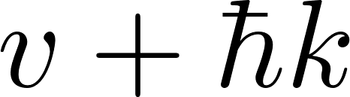
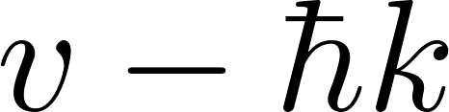
Assumptions for diagonalization: energy ordering
The calculated energy level for absorption is done properly (with recoil)
For spontaneous emission (k not known) we assume no change in lower states
Energy level order
Level[i] for i=
5
5
n=2,
Possible
crossings
4
4
Spontaneous emission
Diagonalization done at
Absorption
Diagonalization is done at
3
3
n=1,
no level crossings
2
2
1
v
1
0
0
v

Slide 7

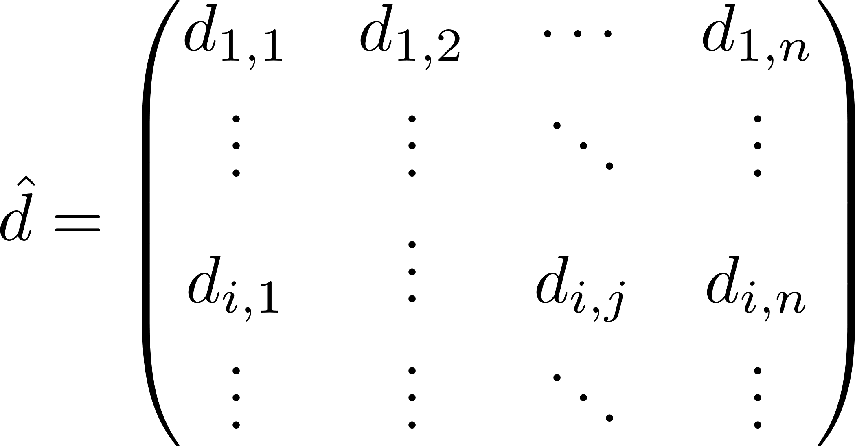
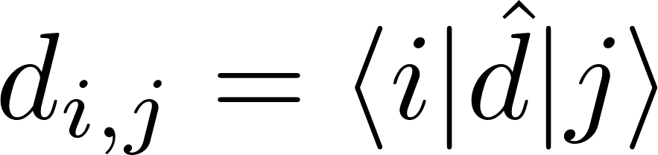
However E’ is not a real vector.
So not very good
V = -d.E
In rotating wave approximation if |1> BELOW |2> we find
So absorption j (=1) →i (=2) is due to -d.E’. Amplitude
So stimulated emission (or spontaneous emission) i (=2) →j (=1) due to ) due to -d.E’^dag
Amplitude
So dipoles are same (conjugated) for absortion or emission

Slide 8
Reaction_rate coded as {n_mol; n_laser; quant_axis; pol_vector; k_eff_laser; final_internal_state}
calcul_rates_molecules
copie_rates_molecules
rates_molecule_spon
→ rate Γ
Loop molecules + levels below
{ num_mol, -1, axe_quant, dq_ij , k_spon, Level[j]}
reaction =
{ n, -1, axe_quant, axe_quant, k_spon=(k,0,0), I_out};
Loop laser + molecules
rates_molecule
rates_single_molecule_laser_level
rate_excitation
Loop
transitions
Rates for intererence laser (not done if diagonalization)
for Different laser,
ionization, BBR)
evolve_step
{ n_mol, n_las, k, k, k, Internal_state_out}
Sontaneous, stimulated, absorption, ionisation …
do_reaction
get_unit_vector_spontaneous_emission
k_photon_transfer_to_particle
such that r(θ, φ) has the probability f(r)= (3/8π)[1-|r.e_p|^2]

Slide 9
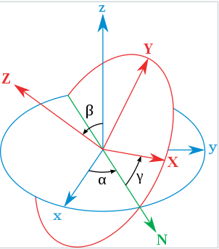
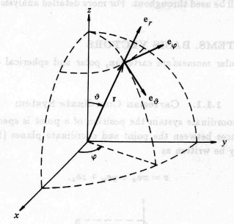
Polar (spherical coodinates)
For the helicity (polarization)
basis
Laser axis
k
e_{Z}
e_{Y}
e_{X}
Lab axis
ψ
Polarization
vector
Euler angle (in Z X Z rotation order)
α=φ+π/2
β=θ
γ=ψ−π/2
Correspond to Euler rotations but for
Z Y Z (φ, θ,ψ) order
To define a laser axis we give the direction of the k vector (in x,y,z, the lab coordinate). Thus (ψ=0) the waists axis X and Y are defined.
For the polarization we add a rotation angle ψ along the Z (k) axis. Example: linear polarization at 45° is: ψ = 45; e_{X}=(e₋₁-e₊₁)/sqrt(2). So in list_param Pol_circulaire_left_sp -0.7071; Pol_circulaire_right_sm[0] 0.7071; angle_psi_degree 45

Slide 10
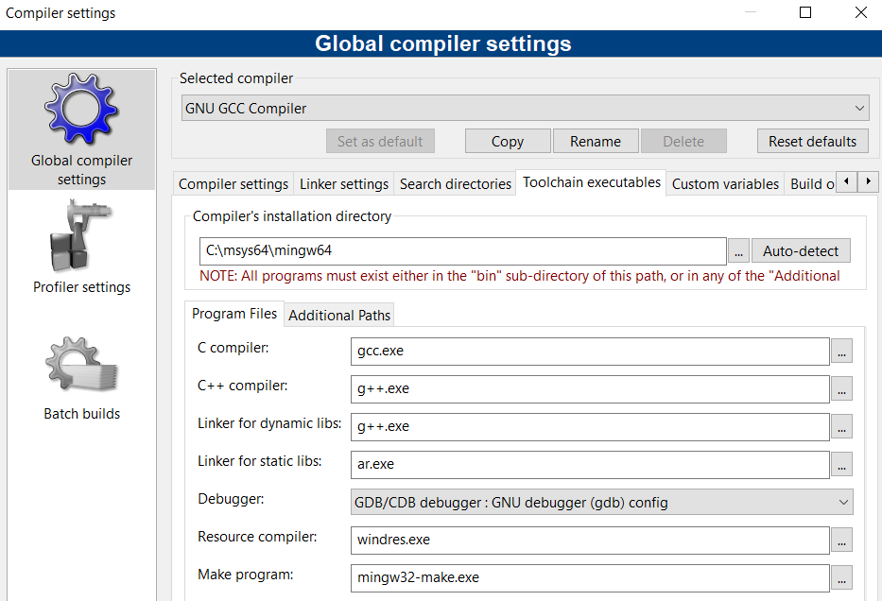
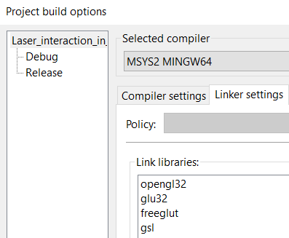
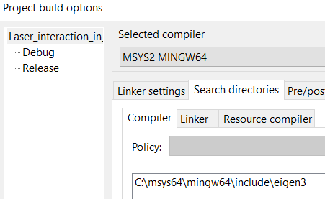
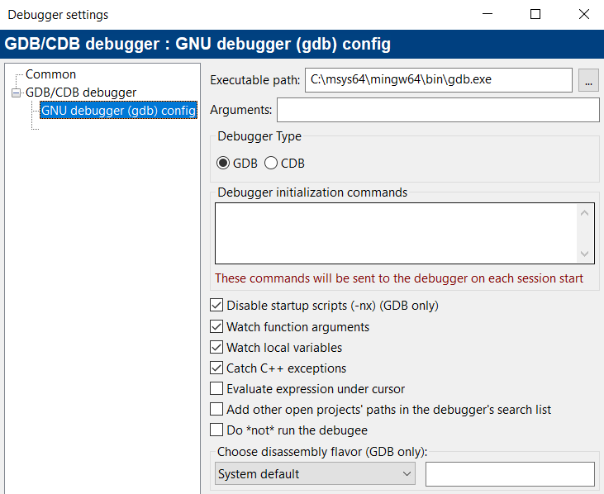
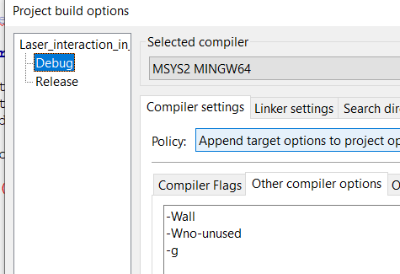
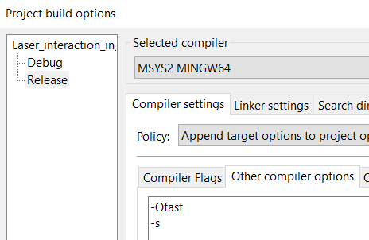

Slide 11
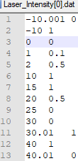

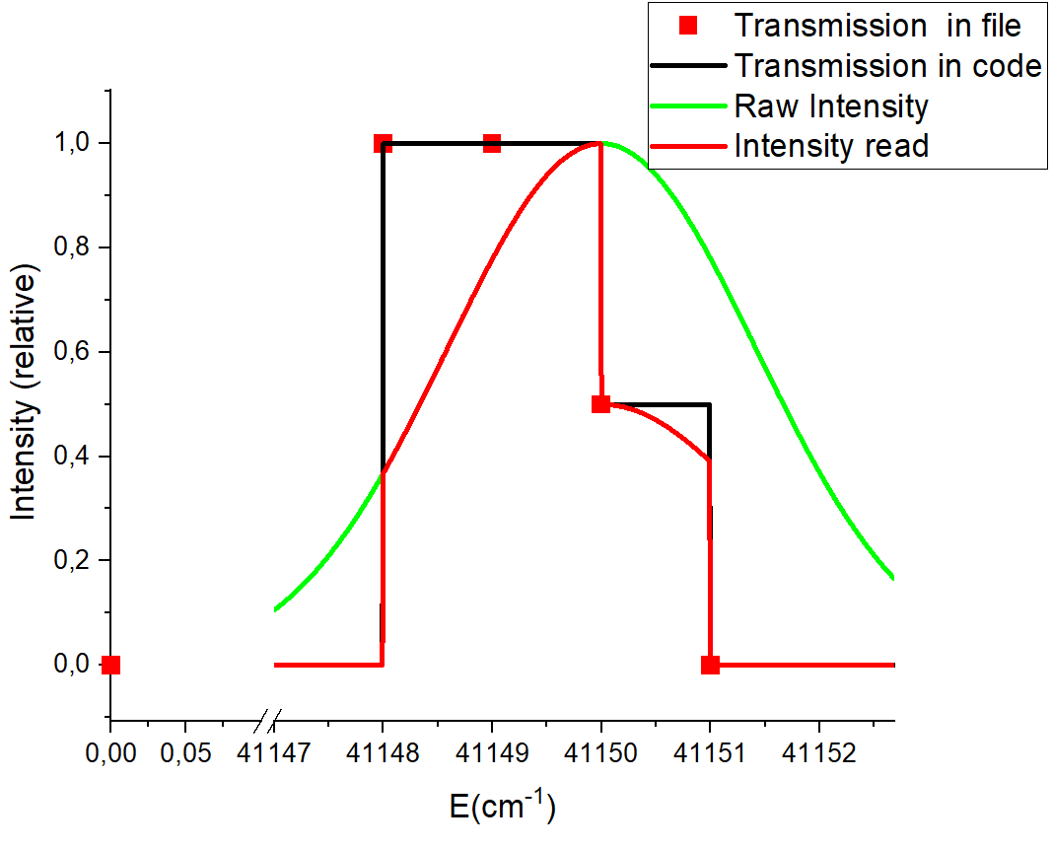
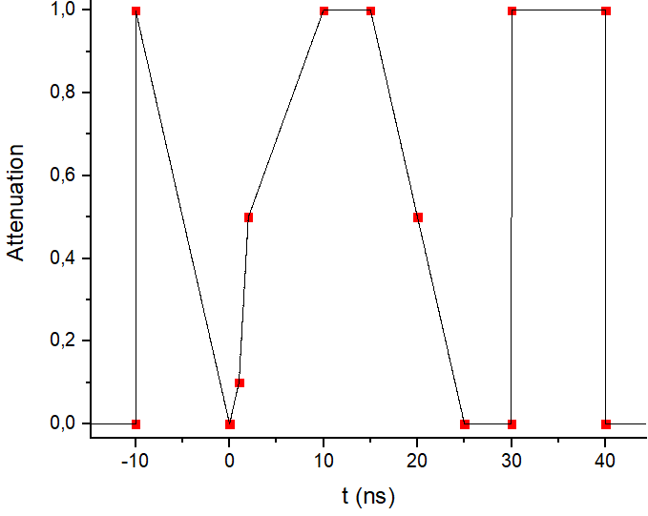
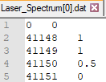
Laser Intensity (versus time)
Laser Spectra
Transmission points in file
Transmission see in the code
Intensity (relative)
File by default (this is the value if no file)
0 1

